Slide 1
Discriminant Analysis

Slide 2
Today . . .
  Basic goals of discriminant analysis
  The iris data as an example

Slide 3
The goal of discriminant analysis is to linear combination of variables that can best separate groups.
In discriminant analysis, the groups are pre-existing and usually have no particular structure (i.e., their formation is not under experimental control).
Classification is usually an emphasis in discriminant analysis.
Notes:
The goal is the development of a linear combination of variables that can best capture this natural separation.
In MANOVA, the groups are created and often part of an experimental design.
Classification is usually an emphasis in discriminant analysis that is not shared with MANOVA.

Slide 4
The linear combinations that discriminant analysis constructs will maximize the ratio of between-groups variance to within-groups variance.
If more than one linear combination can be formed, subsequent linear combinations are independent of prior combinations and account for as much remaining group variation as possible (sound familiar?).

Slide 5
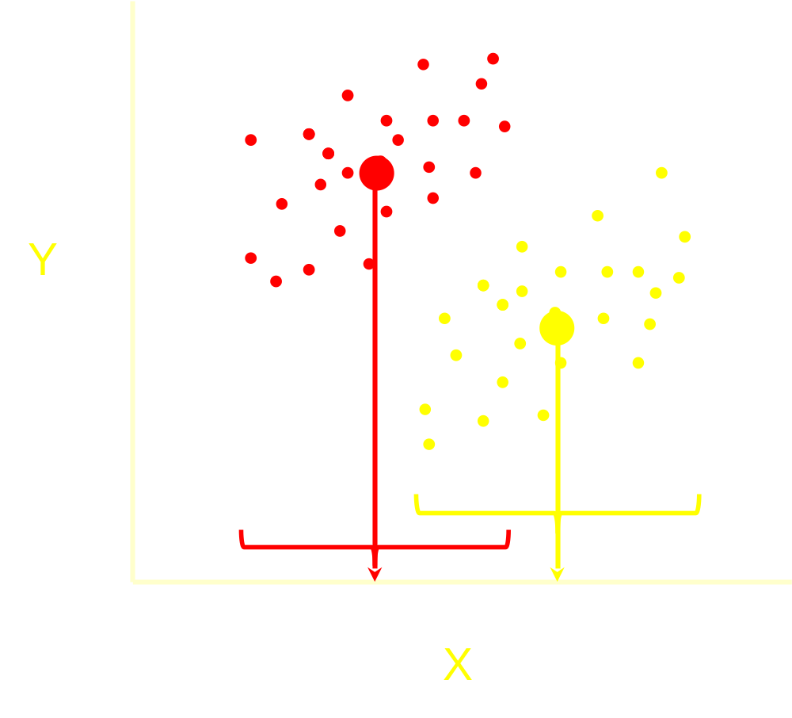
These group can be separated by using variable, X, alone. But, the separation is not terrific and many cases would be misclassified if based only on X.

Slide 6
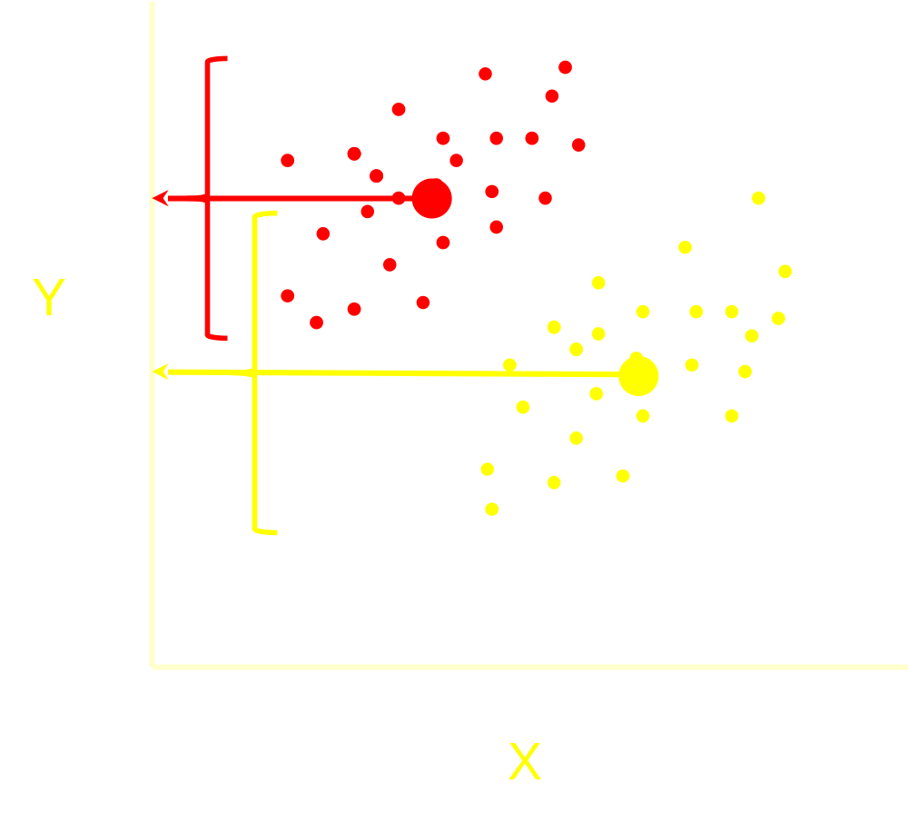
These group can also be separated by using variable, Y, alone. But, here too the separation is not very good and many cases would be misclassified if based only on Y.

Slide 7
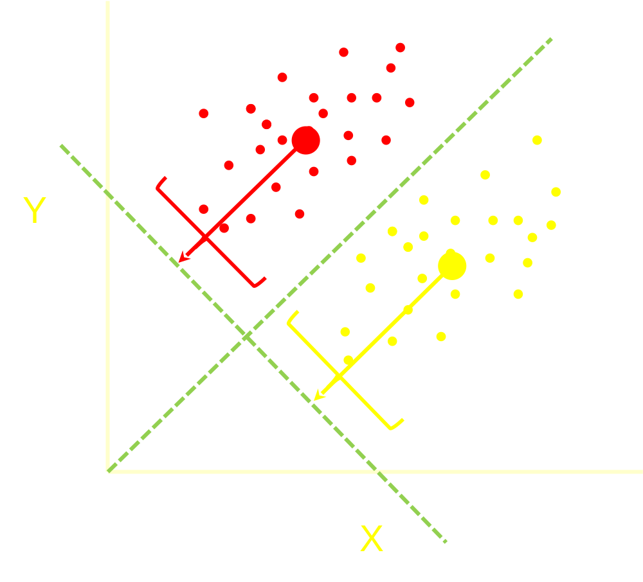
Maximum separation uses both variables at the same time (a linear combination).
More variables could be used and they need not be weighted equally.

Slide 8
The Fisher iris data provide familiar territory for introducing basic concepts.
  We know there are three species in the data set and we know that four measures were taken on each flower.
  What is the best linear combination of those four measures for maximizing the separation of the three species?
  How many linear combinations do we need to produce good separation?
  How good is the separation?
Notes:
Cross-validation is especially important when discriminant analysis is used as an exploratory procedure.

Slide 9
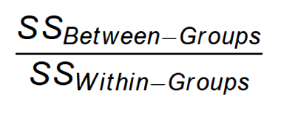
SW = Sepal Width
SL = Sepal Length
PW = Petal Width
PL = Petal Length
Fisher’s original formulation identifies weights that maximize:
Notes:
Technically, the eigenvalues of SS_{W}⁻¹SS_{B} are found. The solution for this approach versus one based on Bayesian posterior probabilities are the same when the assumptions underlying LDA are met.

Slide 10
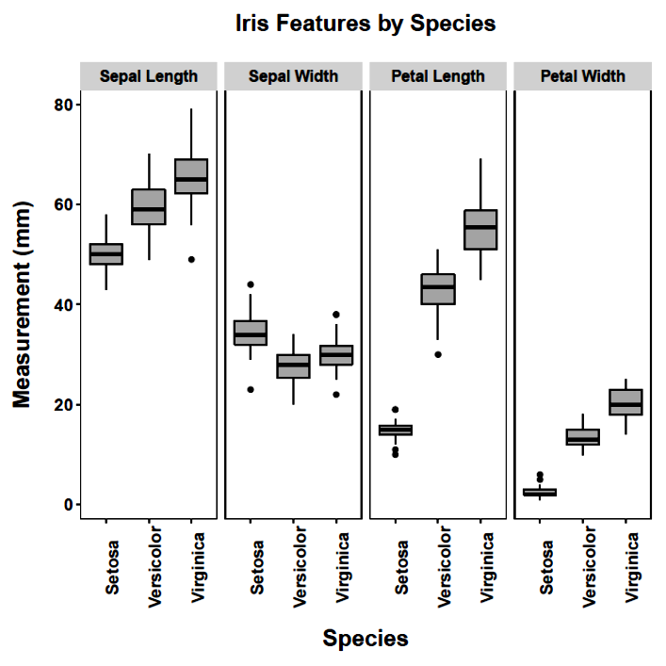
Taken individually, the variables (petal measurements in particular) can separate the groups.

Slide 11
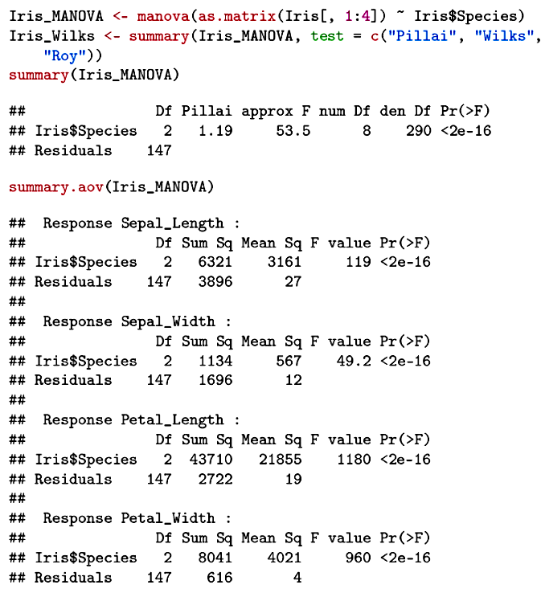
ANOVAs verify the univariate differences for each feature.

Slide 12
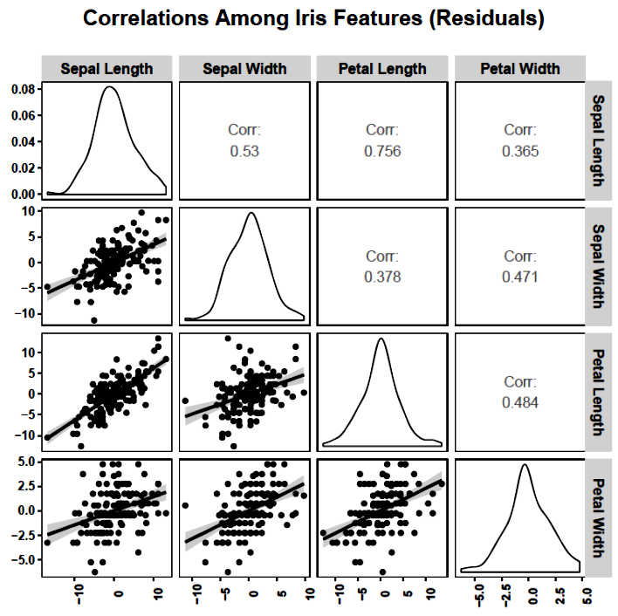
The measures are correlated, so their unique contributions will be important to estimate.
Why are these correlations based on residuals (controlling for species)?

Slide 13
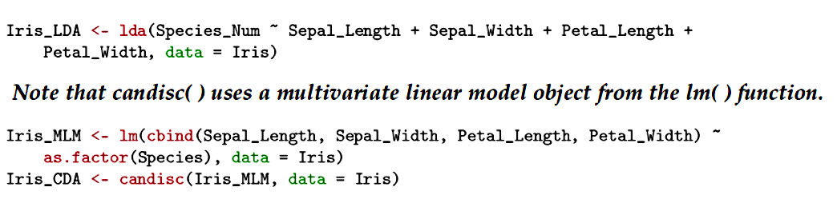
Specify the models and save as objects. The objects will have attributes corresponding to most of the important information from the analysis.
More than one package and function will be necessary to get everything we need for interpretation.

Slide 14
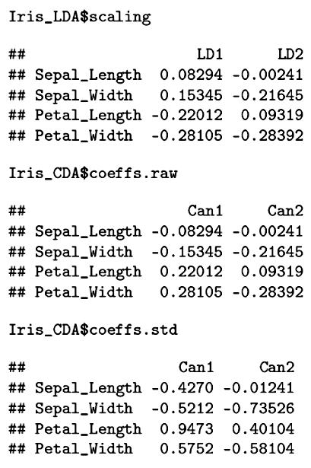
As in multiple regression, there are unstandardized (raw) and standardized coefficients (weights). The former are based on centered, but not standardized, variables.
The standardized coefficients show the unique contributions of the variables.

Slide 15
The maximum number of discriminant functions is the smaller of p (number of variables) or g-1 (with g = number of
groups). The importance of a particular function will not necessarily be apparent from the weights. Also, the variables are correlated, which can complicate interpretation using the weights alone. The simple correlations of each variable with each function (the structure matrix) should also be examined.

Slide 16
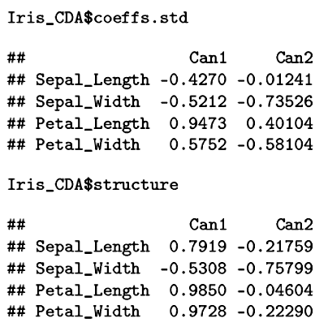



I. Setosa I. Verginica I. Versicolor

Slide 17
How many functions to we need in order to separate the species? What is their relative importance? We can use canonical correlations, eigenvalues, and Wilks’ Λ to help us make these decisions.
If the discriminating variables represent one set and a group of dummy variables derived from group membership represent another set, then the canonical correlation is the maximum linear relation between weighted combinations from those sets. The canonical correlations can be used to determine the relative discrimination of multiple discriminant functions.

Slide 18
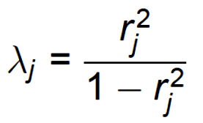
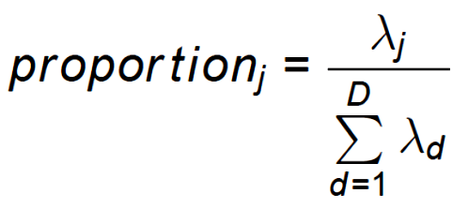
The canonical correlations are related to the eigenvalues (λ_{j}). These eigenvalues refer to the matrix product of SS_{W}⁻¹ and SS_{B}.
The eigenvalues can be used to calculate the proportion of discrimination that is due to each function:

Slide 19
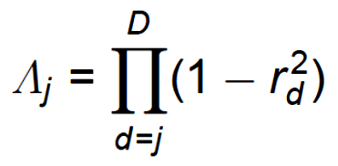
The canonical correlations are also related to Wilks’ lambda (Λ), used to provide a statistical test for the discriminant functions.

Slide 20
Tests of significance in discriminant analysis are made in a step-wise fashion. First, the entire set of functions is tested for significance. If this test is significant, then we conclude that there is significant discrimination possible.
Then the first (and most important) function is excluded and the remainder are tested. If this is not significant, then the first function was the only source of discrimination.
If the remainder is significant, then the first and at least the second are significant sources of discrimination.

Slide 21
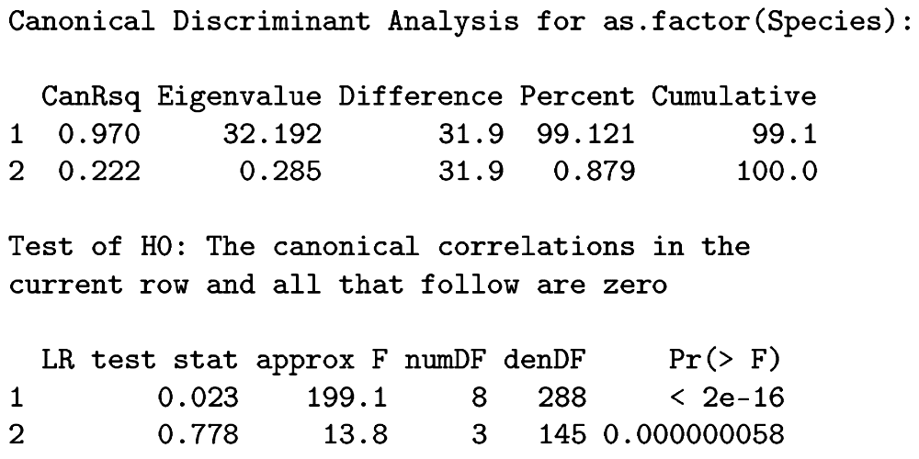
Both discriminant functions are significant but the first is far more important.
Λ₁ = .023 = (1-.970)(1-.222) Λ₂ = (1-.222)

Slide 22
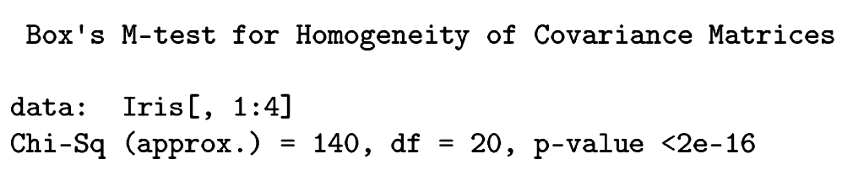
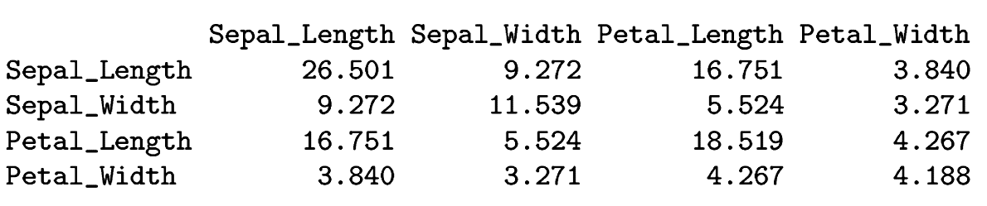
We assume in discriminant analysis that the separate group variance-covariance matrices are homogeneous. This assumption underlies tests used to determine the number of significant functions. Box's test can be used to test this assumption.
The test implies that the pooled variance-covariance matrix does not represent the groups well:

Slide 23
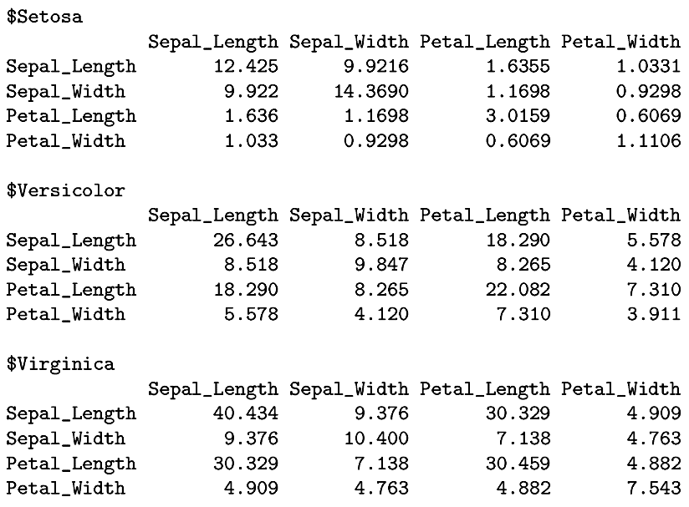
Box’s test indicates that these are not equal. An alternative form of the analysis (quadratic) can be used that does not assume homogeneity.

Slide 24
We also assume multivariate normality for the significance tests as well as the classification part of discriminant analysis. The tests are performed on the residualized data so that species differences do not affect the results. Note that a violation of multivariate normality will also affect the test of homogeneity of covariance matrices.

Slide 25
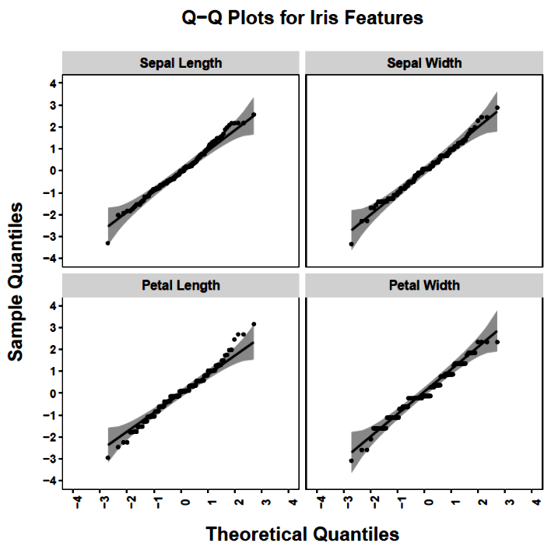

Slide 26
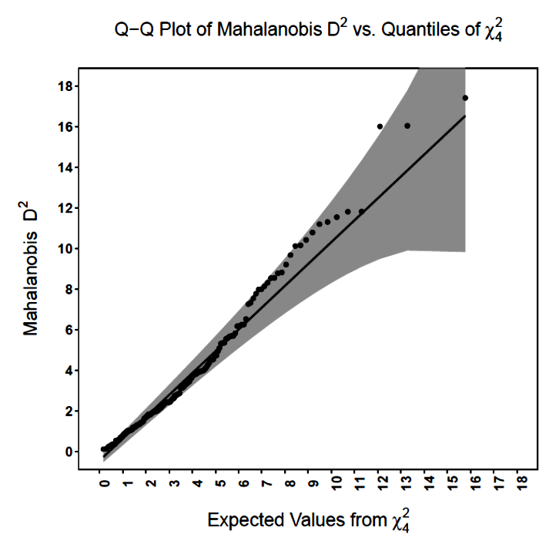

Slide 27
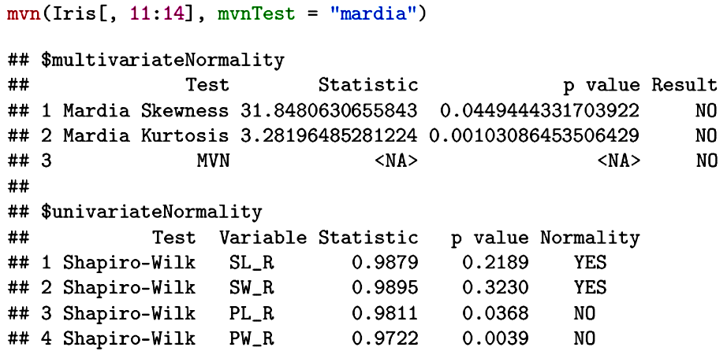
The evidence for non-normality is not overwhelming.

Slide 28
The quality of the discriminant function can be assessed by how well the cases can be classified into their known groups, and, how well new cases can be classified. Three increasingly rigorous classifications can be examined:
1. All cases
2. Leave-One-Out (Jackknife)
3. Separate sample cross-validation.
Classification can be done in several ways. The most common approach uses a Bayesian model that takes prior probabilities into account. Cases are classified into the group for which they have the highest posterior probability.

Slide 29
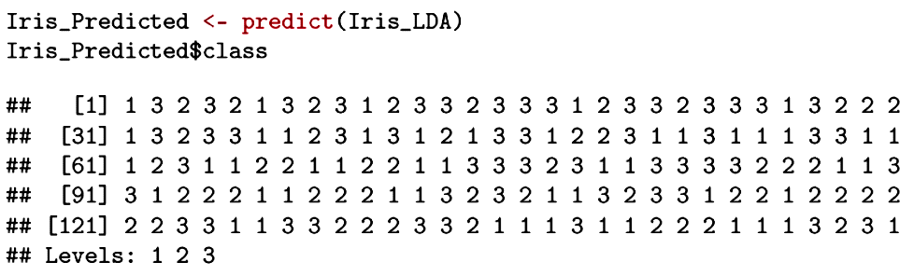
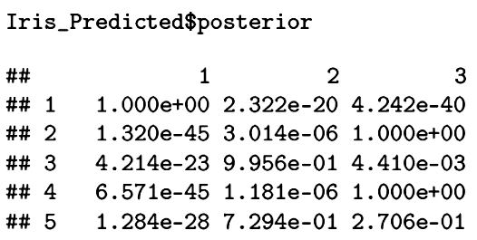
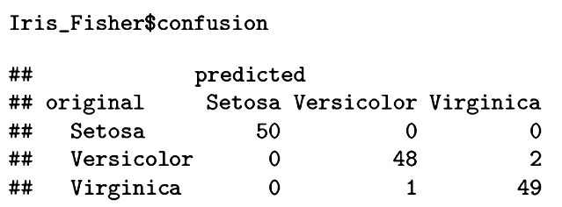
Classification by posterior probabilities is outstanding for the iris data.

Slide 30
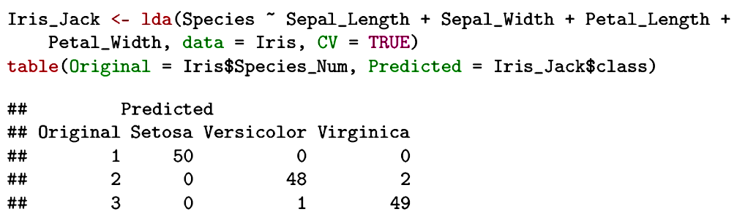
The jackknife procedure will leave each case out in turn, estimate the discriminant analysis with the remaining cases, and then use that information to classify the left-out case. This approach insures that each case is classified with information it did not contribute to in the estimation.

Slide 31
The most convincing cross-validation uses part of the sample (or a separate sample) to estimate the discriminant functions and then applies that solution to the remaining cases. Here the sample is split into random halves. The first sample (called the training set) is used to derive the discriminant functions. Those functions are then used on the second set to classify cases.

Slide 32
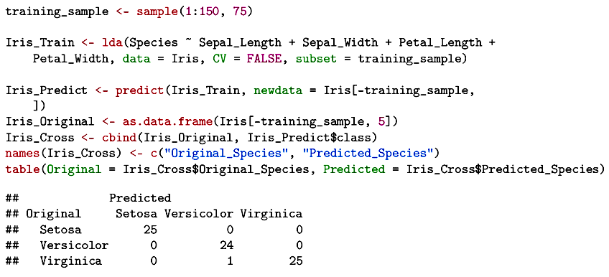
The discriminant functions from the first sample correctly classify 98.7% of the cases in the second sample.

Slide 33
The results of a discriminant analysis can be visualized in a number of ways. When comparing the results across discriminant functions, using a common scale can show the different discrimination power.

Slide 34
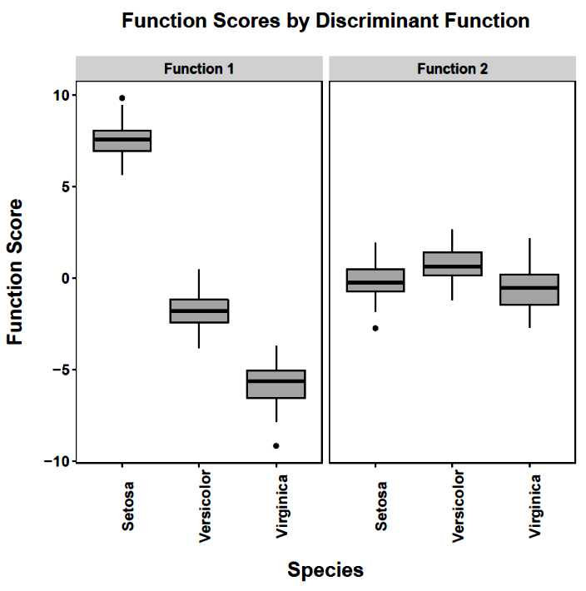
The superior separation with the first discriminant function is evident.

Slide 35
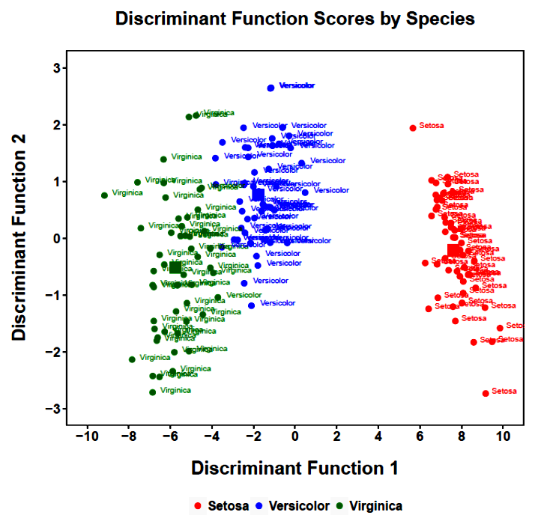
Color is the predicted group. Label is the actual group.
Note that different scaling is used here to reduce clutter.
Misclassification

Slide 36
Next time . . .
  A closer look at classification
  Violation of assumptions

